Slide 1

Ai project
Data Augmentation for Image, Text, Sensor, Audio Corpora
© 2024 OTH Amberg-Weiden
Sristi Bhadani, Soham Joita | Amberg | Supervised by : Prof. Dr.-Ing. Christian Bergler

Slide 2
Agenda
01
Introduction
06
Sensor Augmentation
02
Benefits
07
Audio Augmentation
03
Application
08
Future Work
04
Image Augmentation
09
Conclusion
05
Text Augmentation
10
References
01. July 2024

Slide 3
Data Augmentation
Introduction
Artificially increase the data.
Creation of data variations
Applied on data such as image, text , audio, sensor
01. July 2024

Slide 4
Data Augmentation
Benefits
Enhance model performance
Reduced data dependency
Mitigate overfitting in training data
Improved data privacy
01. July 2024

Slide 5





Data Augmentation
Applications
Healthcare
Finance
Manufacturing
Retail
01. July 2024

Slide 6
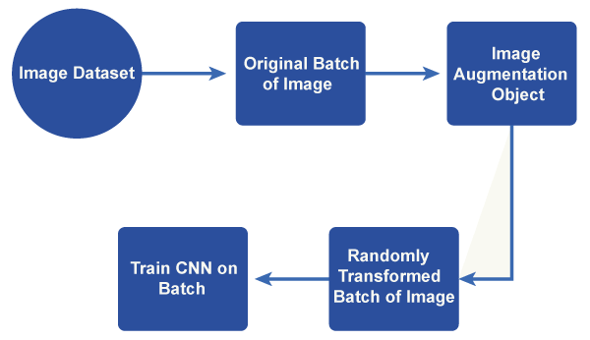
Data Augmentation techniques for Images
How does it work?
01. July 2024

Slide 7
Data Augmentation
Techniques
Compose
Resize
Random Horizontal Flip
Random Rotation
GrayScale
Random Vertical Flip
Color Jitter
Random Affine
Gaussian Blur
Random Posterize
01. July 2024

Slide 8
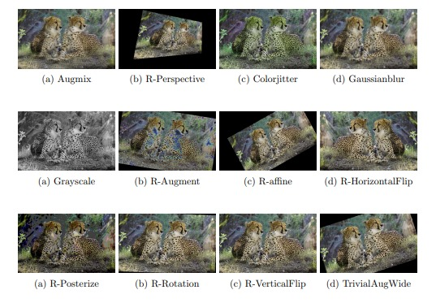

Data Augmentation
Results
Orignal Image
01. July 2024

Slide 9
Data Augmentation
Techniques for Text
Synonym replacement
Add Noise
Random Insertion
Random Deletion
Random Swap
Paraphrasing
Style Transfer NMT
Stochastic Text Generation
Masking
Grammar Correction
World Shuffling
Bert Augmentation
Back Translation
01. July 2024

Slide 10
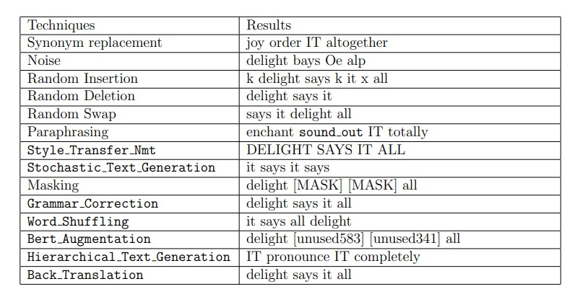
Data Augmentation
Results
“Delight says it all”
Orignal Text
01. July 2024

Slide 11
Data Augmentation
Techniques for Sensor
Gaussian Noise
Uniform Noise
Jitter
Scaling
Generate Random Curves
Permutation
01. July 2024

Slide 12
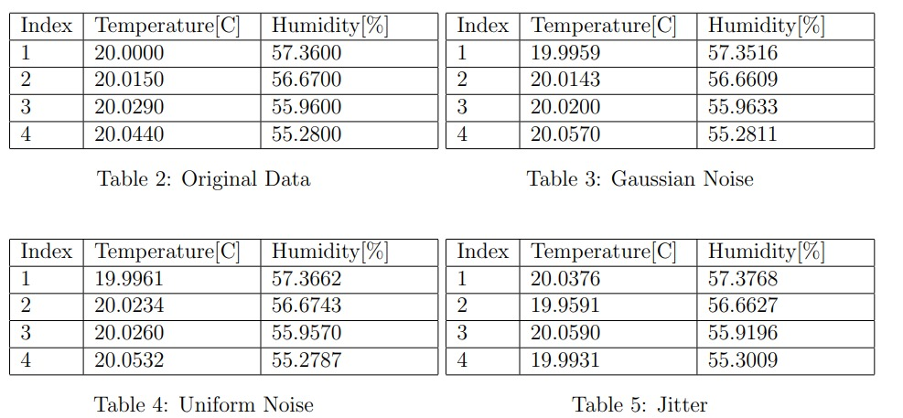
Data Augmentation
Results
01. July 2024

Slide 13
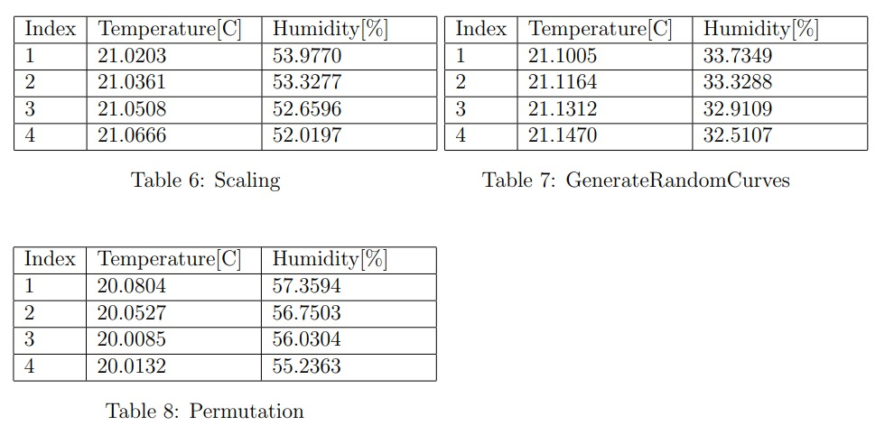
Data Augmentation
Results
01. July 2024

Slide 14
Data Augmentation
Techniques for Audio
Add Noise
Reverse Audio
Change Speed
Slow Down Audio
Add Echo
Add Sonic Boom Effect
Pitch Shift
Time Masking
01. July 2024

Slide 15
Data Augmentation
Future Work
Implementation of Advanced Techniques such as GAN, VAE
Cross Model Augmentation
Training the model and evaluating the performance with the techniques
01. July 2024

Slide 16
Data Augmentation
Conclusion
Data Augmentation is a powerful tool to transform the performance of machine learning models
By creatively expanding the dataset we can build accurate, reliable, and versatile AI system
01. July 2024

Slide 17
Data Augmentation
References
https://aws.amazon.com/what-is/data-augmentation/
https://www.javatpoint.com/data-augmentation-in-machine-learning
01. July 2024

Slide 18
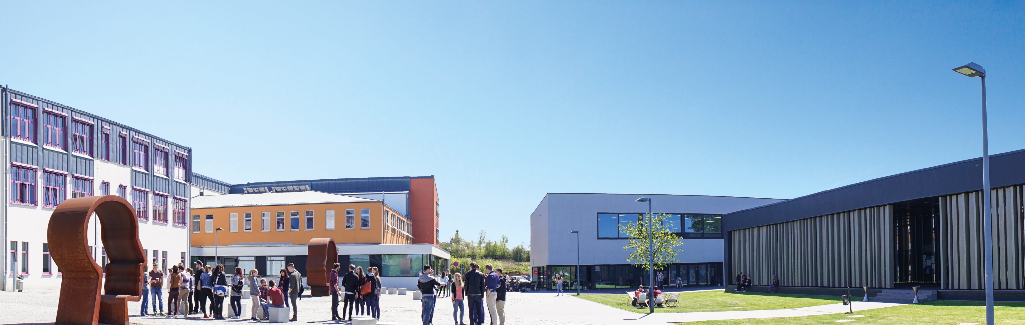
Thank You

